Slide 1


ADVANCED MODELLING FOR OPERATIONS ASSIGNMENT 2
Almir Gungor 10752670
Berk Ceyhan 10761821
Cagatay Onur 10781315
Lorenzo Ghedini 10586137

Slide 2

TABLE OF CONTENTS
Planning of Experiments
Performance Measure of Interests
List of Possible Factors
Factor Levels and Single Factor Experiments
Number of Runs
ANOVA : DOE Python Script
Varying Battery Sizes, Fixed Charging Policy
A Hypothetical Business Case
Base Charging Policy // 4 vans// Varying Battery Sizes
Variables
Parameters
New Charging Policy
Decision Making Using Simulation Output Analysis: Solving the Business Case
Conclusion
2

Slide 3





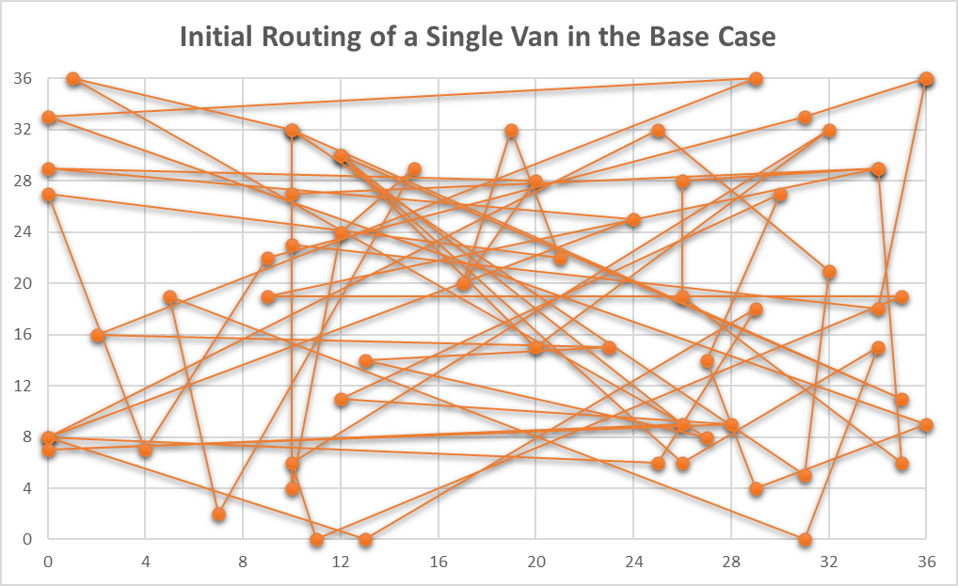




PLANNING OF EXPERIMENTS: Performance Measure of Interests
Performance Measure of Interests
1) Minimum number of vans that satisfies 8 hours constraint to serve 60 customers: This is the most critical performance measure, due to the fact that minimizing the number of runs will impact the profitability of the business severely, and the needed number of vans must be identified by running different experiments by different system configurations. This is the selected system performance to measure. (It will be explained in more detail in the next slide)
2) Waiting times of the vans at the charging station queues: If the company wants to evaluate the new charging policy (explained in Assignment 1), this system performance can be used to evaluate the benefits of this new charging policy. If this waiting time decreases with the new charging policy, the tour end times of the vans will be decreases consequetively.
3) Maximum distance travelled by all the vans: To measure the performance of routing, this can be a good system performance to measure. This will have an important impact on the tour end times of vans. If the goal is to measure specifically the performance of new routing policies, this can be used.
4) The total energy consumed by the vans: With the green logistics is becoming an important aspect of sustainability, this system performance can be measured to evaluate the sustainability of the logistics operations of the company.
5) Total cost including all the aspects mentioned above: A cost function, using weighted averages of the performance measures mentioned above depending on their importance, can be used to evaluate the total performance of the last mile delivery operations. However, this function is not easy to construct, and it can vary a lot depending on the objectives of a specific company.
3

Slide 4
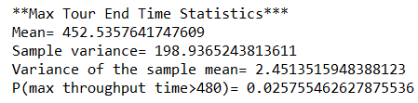
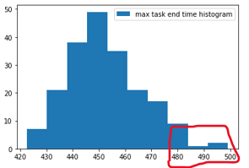
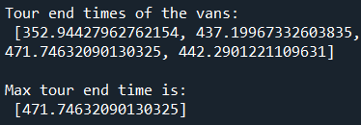
PLANNING OF EXPERIMENTS: Performance Measure of Interests
How to measure minimum number of vans that satisfies 8 hours constraints to serve 60 customers:
As mentioned in the previous slide, our system performance of interest is minimum number of vans that satisfy 8 hours constraint. This system performance is chosen due to the fact that it is the most important measure to evaluate the performance of the overall last mile delivery operations, compared to other possible system performances. Because, if it can be minimized, the company will make a significant amount of saving.
How to measure minimum number of vans needed?
After each tour finishes, we will collect the data of maximum of all tour end times of all the vans in a single tour. For example:
The recorded value will be 471.75 minutes. The main reason behind calculating only the maximum of these tour end times is the fact that the main goal is to have all our vans finishing their tours in 8 hours. Therefore, we are focusing on the maximum of them, which must be lower than 8 hours.
Statistics calculation and determining minimum number of vans needed
To sum this part up, we can say that maximum tour end time statistics will be used as a proxy of the minimum number of vans. As a default setting, 4 vans will be tried, because it is enough to satisfy 8 hours constraint in most of the cases. Whenever distribution of maximum tour end data significantly exceeds 8 hours constraint (this part depends on the preferences of the decision maker), we will conclude that 4 vans are not enough, so 5 vans will be used.
For example:
With the statistics are calculated for maximum througphut data:
Let P(max throughput time>8 hours)=0.09
The decision maker believes that max throughput time can exceed 8 hours constraint. at most 0.05
0.09>0.05
In this case, the decision will be 5 vans instead of 4, due to the fact that the decision maker is not okay with 0.09 of the tours exceeding 8 hours constrain.
After recording the data of maximum tour end times coming from multiple runs, we can have results similar to the ones below:
The decision makers can use this data to make managerial decisions, depending on their preferences. In the example above, with using 4 vans, in 0.975 of the cases the tour can be completed in 8 hours by all vans. If the company is willing to accept 0.025 probability of going overtime,they can use 4 vans. If not, setting it to 5 vans will prevent overtimes almost in all cases.
4

Slide 5



PLANNING OF EXPERIMENTS: List of Possible Factors
Possible Factors
1) Charging Policy: Due to the fact that electrical vans may need charging to complete their tours, charging policy of the company may affect the performances severely. This is an important factor to use due to several reasons such as waiting times at the charging station queues may differ from one policy to another (which effects max tour end time of the vans and consequently the company may face overtime costs. (This is deeply explained in the Assignment 1). This factor is selected to be used in our experiments due to its significant effect on the maximum tour end time, and also due to the fact that the companies can easily try our new charging policy in the short term.
2) Battery Size: Vans with different battery sizes may have different daily costs. The vans with large batteries will have higher daily operating costs, and the ones with the smaller battery sizes will habe lower daily operating costs. Therefore, different battery sizes and their effect on the maximum tour end times are worth evaluating, depending on which the company can identify different opportunites of cost saving. This factor is selected to be used in our experiments, due to the fact that it has a big impact on the maximum tour end time of the vans, and also the fact that the companies which rent vans can easily adjust their fleet of vans with varying battery sizes.
3) Warehouse Location: This factor may be investigated for long term strategic decisions, if the company is evaluating different possible locations of a warehouse to serve different areas. Different locations will have different impacts on the maximum tour end times and will change the number of vans needed to complete a tour, due to the fact that the total distance travelled needed to serve 60 customers will vary depending on the warehouse location. Moreover, the rent prices of the warehouse real estate will vary depending on the location. Therefore, this factor may be interesting to investigate for long term decisions.
4) Routing Policy: To define the routings of the vans, different policies can be used. Both optimization and also heuristic methods can used to define routings, which will have different travel distance, and consequetively different max tour end times.
25 kwh
35 kwh
5

Slide 6
PLANNING OF EXPERIMENTS: Factor Levels and Single Factor Experiments
Factor Levels
Factor 1: Charging Policy
Factor Levels: [0,1]
0: Base Case Charging Policy
1: New Charging Policy (Explained in Assignment 1)
Changing the factor level from «0» to «1», we will observe the change in the maximum tour end time of the vans. Note that this is not a numerical factor, but a factor that is referring to a policy.
Single Factor Experiments
We will use single factor experiments for 2 factors just mentioned: Charging Policy and Battery Size.
Our experiments will be conducted by:
Fixing the charging policy and conducting
experiments with differing battery sizes:
In this case, we will run 2 experiments (Experiment No: 1 and 2) and we will test if the varying battery sizes effect the maximum tour end time (which is a proxy of minimum number of vans to serve customers in 8 hours time period)
2. Fixing the battery size, and conducting experiments with differing charging policies:
In this case, we will run 6 experiments (Experiments no: 3,4,5,6,7,8) and we will test if the varying charging policies effect the maximum tour end time (which is a proxy of minimum number of vans to serve customers in 8 hours time period)
Factor 2: Battery Size
For factor levels of battery size, different battery sizes for different vans can be used and this will be shown as:
Factor Levels:
[20,20,20,20]
[25,25,25,25]
[30,30,30,30]
[35,35,35,35]
[30,30,20,20]
[25,25,20,20]
Experiment No. | Charging Policy​ (Fixed) | Battery Size​ (Changing)
1​ | Base Case Policy | [20,20,20,20] ​
 |  | [25,25,25,25]​
 |  | [30,30,30,30]​
 |  | [35,35,35,35]​
 |  | [30,30,20,20]​
 |  | [25,25,20,20]​
2 | New Policy | [20,20,20,20] ​
 |  | [25,25,25,25]​
 |  | [30,30,30,30]​
 |  | [35,35,35,35]​
 |  | [30,30,20,20]​
 |  | [25,25,20,20]​
Experiment No. | Battery Size​ (Fixed) | Charging Policy​ (Changing)
3 | [20,20,20,20] ​ | New Policy
 |  | Base Case Policy
4 | [25,25,25,25]​ | New Policy
 |  | Base Case Policy
5 | [30,30,30,30]​ | New Policy
 |  | Base Case Policy
6 | [35,35,35,35]​ | New Policy
 |  | Base Case Policy
7 | [30,30,20,20]​ | New Policy
 |  | Base Case Policy
8 | [25,25,20,20]​ | New Policy
 |  | Base Case Policy
NOTE:
Batery Size: [x,y,z,t] means that:
Van_0 battery = x kwh
Van_1 battery = y kwh
Van_2 battery = z kwh
Van_3 battery = t kwh
With the changing battery sizes, we will observe the change in the maximum tour end time. If with smaller batteries still the maximum tour end times can satisfy 8 hours constraint, that means an opportunity for the company to make some savings. Also, some flexible options ( [30,30,20,20]) with different battery sizes for different vans will be tried, to see if a right combination can be found.
6

Slide 7



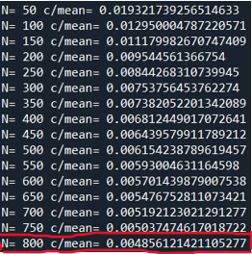
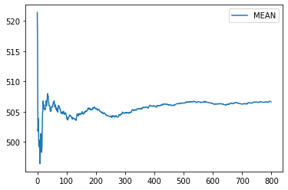
PLANNING OF EXPERIMENTS: Number of Runs
Due to the fact that different scenarios have different standard deviation of the sample mean, each scenario needs different number of runs to satisfy the constraint of:
Half Width of the Confidence Interval (c) < 0.005 * Mean
Therefore, we calculated number of runs for different scenarios, and selected the highest number of runs needed among all different scenarios.
The Procedure to Determine Number of Runs (Python Script Section 11)
1. We selected half width of the confidence interval (c)
Half width is set to 0.005 of the mean of maximum tour end time, in order to have a precise estimation of the mean.
4. We run N replications to calculate half width interval
This procedure is followed for all configurations (12 scenarios) considering the 2 factors of: Charging Policy and Battery Size. In the case of:
Battery Size: [20,20,20,20]
Charging Policy=0
We needed 800 runs to satisy the condition of half width. This was the case in which we needed the biggest number of runs. Therefore, we decided to use 800 runs, for our experiments to measure the maximum tour end time, which is a proxy of minimum number of vans to serve 60 customers in 8 hours (explained in slide 4) to be used ,which is our system performance measure of interest.
5. We check the condition of:
c < 0.005 * Mean of maximum tour end times
2. We chose the confidence level (1- alpha) and initial value number of runs (N)
6. We start from the initial value of N=50, and increase it by 50 for the next step, if the condition is not met
(Python Script Section 2.5)
alpha= 0.05
N= 50
3. We calculated the percentile of the t-distribution
with N-1 degrees of freedom and 1-alpha confidence level
7
N=800 IS SELECTED

Slide 8
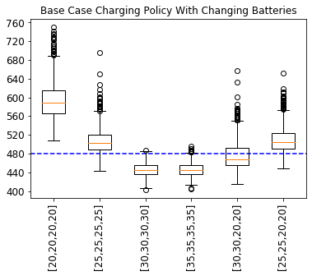
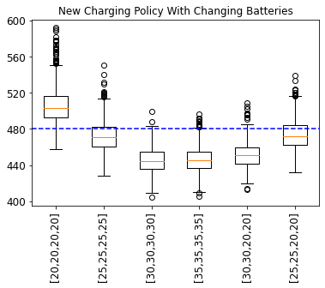
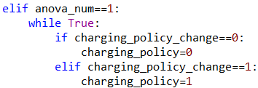


Varying Battery Sizes, Fixed Charging Policy
DOE Python Script
Anova_num=0: Fixed charging policy, varying battery sizes experiments
Anova_num=1: Fixed battery size, varying charging policy experiments
Experiment 1
Charging policy= Base Case Charging Policy
Battery Size= Changing
Experiment 2
Charging policy= New Charging Policy
Battery Size= Changing
Anova_num=1 : How does the code work? (Same logic for Anova_num=0)
Python Script Section 11
1. The user sets anova_num=1
2. The user fixes the battery size and runs the code
3. The code performs Anova Test with fixed battery size and changing charging policies. (Detailed explanation is provided in Python Script Assignment_2_Anova Section 11)
With the Base Case charging policy and varying battery sizes, we can conclude that:
The change in the battery size significantly effects the maximum tour end time with the p-value 0
Battery sizes [30,30,30,30] and [35,35,35,35] giving very similar results. This is because the van does not need any charging to complete the tour in both of these battery sizes.
With these 2 battery sizes, Base Case charging policy and 4 vans, the tour can be completed in 8 hours.
With the New Charging policy and varying battery sizes, we can conclude that:
The change in the battery size significantly effects the maximum tour end time with the p-value 0
Battery sizes [30,30,30,30] and [35,35,35,35] giving very similar results. This is because the van does not need any charging to complete the tour in both of these battery sizes.
With the new charging policy, battery size [30,30,20,20] also gives promising results
8
Charging_policy_change parameter is used to change the charging policy until both of them used in the experiment.

Slide 9
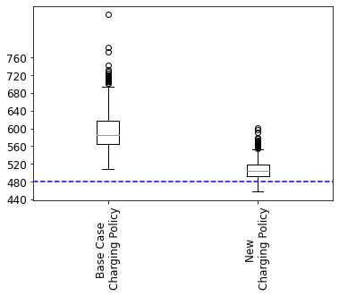
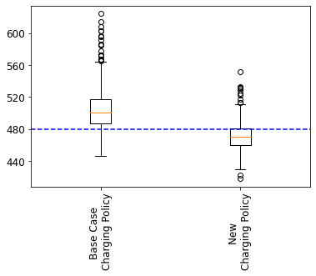
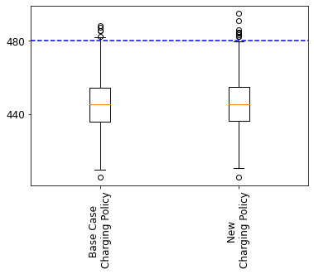
Varying Charging Policy, Fixed Battery Size
Experiment 3
Battery Size: battery_size = [20,20,20,20]
Charging policy= Changing
Experiment 4
Battery Size: battery_size = [25,25,25,25]
Charging policy= Changing
Experiment 5
Battery Size: battery_size = [30,30,30,30]
Charging policy= Changing
With the battery size [20,20,20,20] and varying charging policy, we can conclude that:
The change of the charging policy significantly impact the maximum tour end time with the p-value 0
Even though new charging policy improves the results, with the battery size [20,20,20,20], it seems that the tour cannot be completed in 8 hours
With the battery size [25,25,25,25] and varying charging policy, we can conclude that:
The change of the charging policy significantly impact the maximum tour end time with the p-value 1.63e-166
The new charging policy improves the results and the maximum tour end time seems to be under 8 hours in most of the cases
With the battery size [30,30,30,30] and varying charging policy, we can conclude that:
The change of the charging policy has no significant impact on the tour end time with the p-value 0.7703
This result is due to the fact that the vans do not need any charging with this battery size, because it is large enough to complete a tour. Therefore, no impact of the new charging policy can be seen with this large battery size.
9

Slide 10
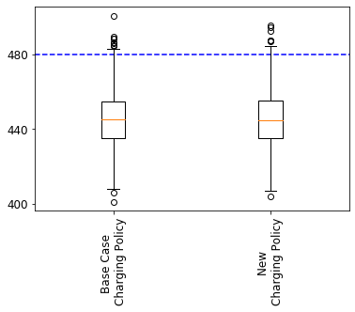
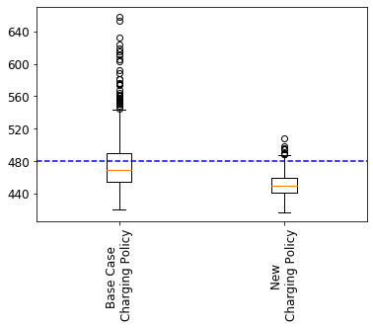
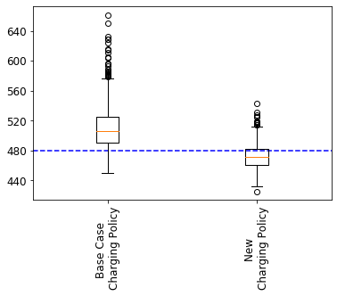


Varying Charging Policy, Fixed Battery Size
Experiment 6
Battery Size: battery_size = [35,35,35,35]
Charging policy= Changing
Experiment 7
Battery Size: battery_size = [30,30,20,20]
Charging policy= Changing
Experiment 8
Battery Size: battery_size = [25,25,20,20]
Charging policy= Changing
With the battery size [35,35,35,35] and varying charging policy, we can conclude that:
The change of the charging policy has no significant impact on the tour end time with the p-value 0.6352
This result is due to the fact that the vans do not need any charging with this battery size, because it is large enough to complete a tour. Therefore, no impact of the new charging policy can be seen with this large battery size.
With the battery size [30,30,20,20] and varying charging policy, we can conclude that:
The change of the charging policy significantly impact the maximum tour end time with the p-value 1.15e-78
The new charging policy improves the results and the maximum tour end time seems to be under 8 hours in most of the cases.
With the battery size [25,25,20,20] and varying charging policy, we can conclude that:
The change of the charging policy significantly impact the maximum tour end time with the p-value 4.80e-180
The new charging policy improves the results and the maximum tour end time seems to be under 8 hours in most of the cases.
10

Slide 11
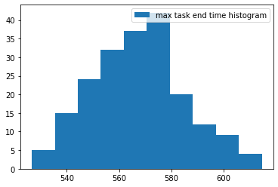
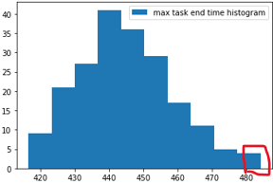
A Hypothetical Business Case
Below, we will be explaning a hypothetical business case, in which the decision maker is trying to identify the number of vans to use depending on varying battery sizes for different vans and also the charging policy to use. In the following slides, the decisions about the number of vans will be made depending on the preferences of the decision makers described in this hypothetical business case.
EXPRESS COURIER X is an express courier, operating in Europe. They are transforming their traditional last mile delivery operations to be performed by electric vans. With the city infrastructures are developing to support charging of the electric vehicles more and more, last mile delivery with electric vans has become a viable option in the last years for the courier companies.
The challange for the company contains 3 aspects:
Evaluating the number of vans needed to serve the areas
Evaluating different vans with different battery size options, which have different daily costs
Evaluating a new charging policy, which is believed to have a good chance of improving the performances
The operations manager believes that evaluating different battery sizes may be an opportunity for cost saving, due to daily costs of those batteries vary. The daily costs of the vans are rougly as below:
35 kwh battery vans= 150 €/day
30 kwh battery vans= 135 €/day
25 kwh battery vans= 120 €/day
20 kwh battery vans= 105 €/day
The operations manager wants to have all the vans serving to the same area complete their tours in 8 hours in 95% of the cases (only 5% of the tours are allowed to exceed 8 hours constraint). They already know from previous simulations that 3 vans are not possible to serve 60 customers in 8 hours. Specifically, they are evaluating an area, to which they can easily serve with 4 vans all having 35 kwh batteries. However, evaluating the options with different battery sizes can lead to big cost savings for the company. Moreover, having a new charging policy considered to be introduced for the last mile delivery operations, the operations manager believes that they have a good chance of doing the last mile deliveries with vans having smaller battery sizes.
Max Tour End Time: 3 vans
Max Tour End Time: 4 vans
Not possible to serve 60 customers in 8 hours with 3 vans, even with biggest batteries
60 customers can easily be served in 8 hours by 4 vans using 35kwh batteries
Therefore, 3 vans and 5 vans will not be tried, and we will try to identify only in which cases 4 vans would not be enough. (You will see that with changing battery sizes 4 vans may not be enough in some cases, due to the trade-off of choosing smaller batteries increasing the maximum tour end time)
Summarizing the challange
Find the right combination of :
Battery sizes for different vans
Charging policy
To achieve cost savings, and still being able to serve 60 customers with 4 vans in 8 hours with 95% confidence level.
11

Slide 12
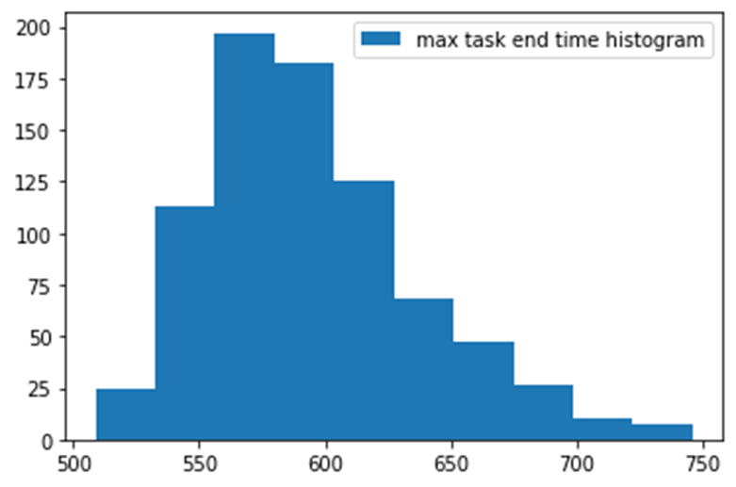
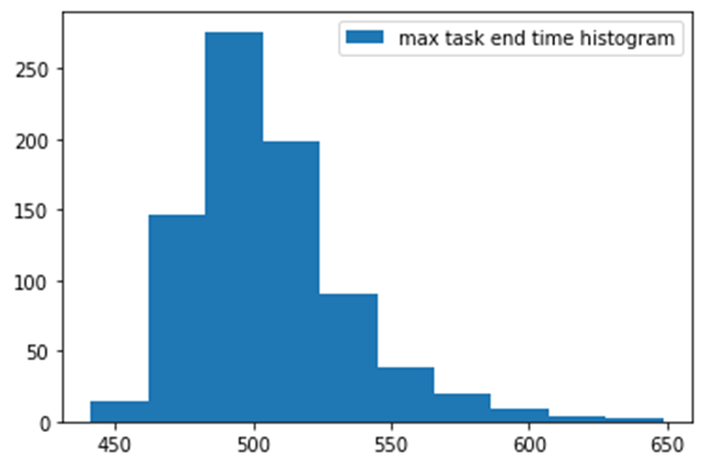
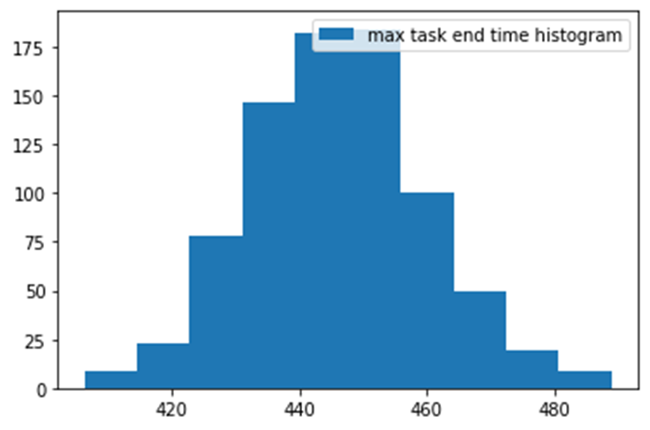
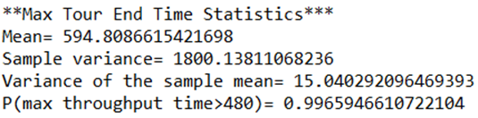
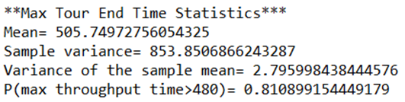
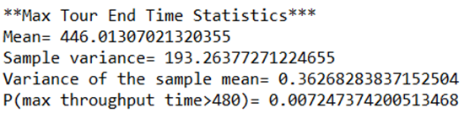
Base Case Charging Policy, Varying Battery Sizes, 4 vans
battery_size = [20,20,20,20]
Charging policy= Base Case
battery_size = [25,25,25,25]
Charging policy= Base Case
battery_size = [30,30,30,30]
Charging policy= Base Case
With the probability of 0.9965, 4 vans cannot satisfy 8 hours constraint since the company set the threshold for probability of maximum tour end time exceeding 8 hours as 0.05:
0.9965 > 0.05
So, 4 vans are NOT enough with this battery size and charging policy
With the probability of 0.81, 4 vans cannot satisfy 8 hours constraint since the company set the threshold for probability of maximum tour end time exceeding 8 hours as 0.05:
0.81 > 0.05
So, 4 vans are NOT enough with this battery size and charging policy
With the probability of 0.00724, 4 vans cannot satisfy 8 hours constraint since the company set the threshold for probability of maximum tour end time exceeding 8 hours as 0.05:
0.00724 < 0.05
So, 4 vans are enough with this battery size and charging policy
12
12
Note: The sample variance is very huge in this case, which shows unreliability of the base case charging policy
Note: The sample variance is very huge in this case, which shows unreliability of the base case charging policy
Note: The sample variance decreases, because with this battery size the van does not need any charging to complete the tour, so the variability is mainly caused by speed and unloading time stochasticity

Slide 13
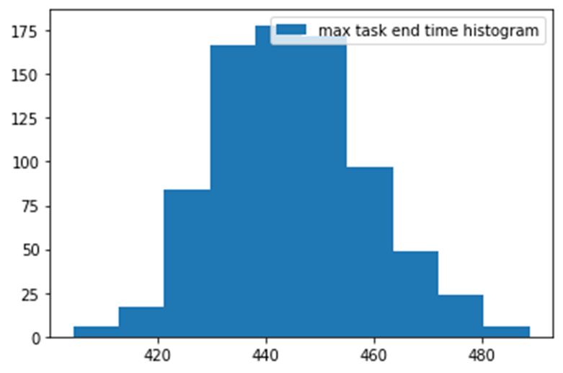
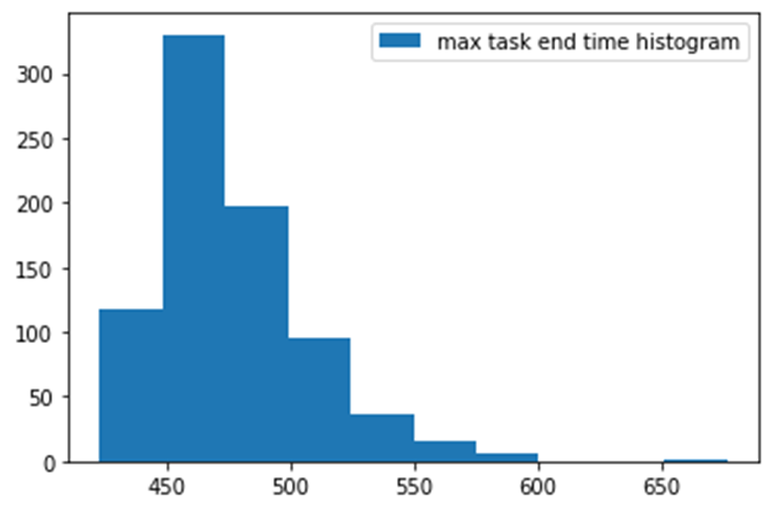
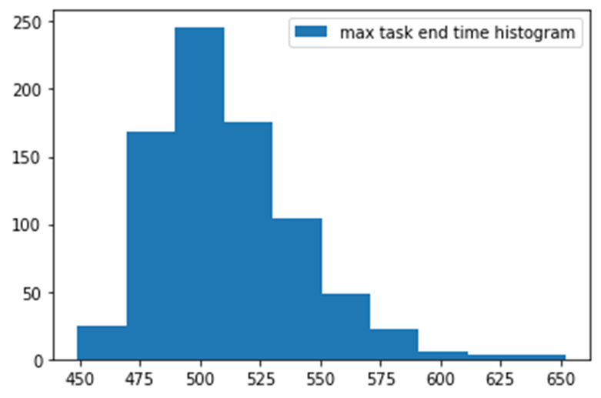
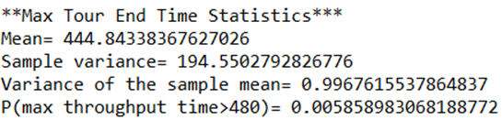
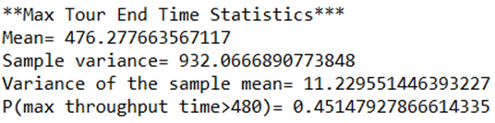
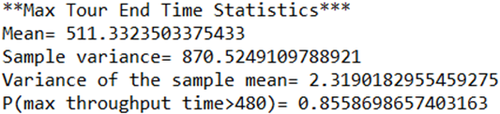
Base Case Charging Policy, Varying Battery Sizes, 4 vans
battery_size = [35,35,35,35]
Charging policy= Base Case
battery_size = [30,30,20,20]
Charging policy= Base Case
battery_size = [25,25,20,20]
Charging policy= Base Case
With the probability of 0.0058, 4 vans cannot satisfy 8 hours constraint. Since, the company set the threshold for probability of maximum tour end time exceeding 8 hours as 0.05:
0.0058<0.05
So, 4 vans are enough with this battery size and charging policy
With the probability of 0.45, 4 vans cannot satisfy 8 hours constraint. Since, the company set the threshold for probability of maximum tour end time exceeding 8 hours as 0.05:
0.45>0.05
So, 4 vans are NOT enough with this battery size and charging policy
With the probability of 0.855, 4 vans cannot satisfy 8 hours constraint. Since, the company set the threshold for probability of maximum tour end time exceeding 8 hours as 0.05:
0.855>0.05
So, 4 vans are NOT enough with this battery size and charging policy
13

Slide 14
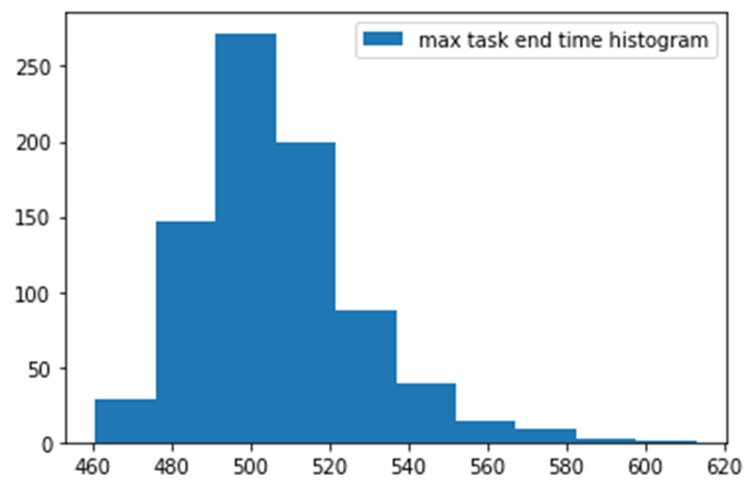
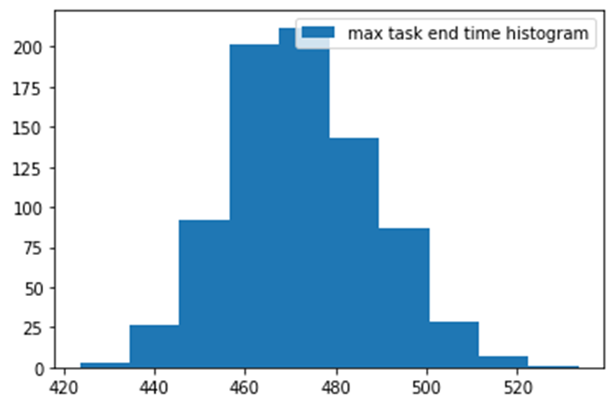
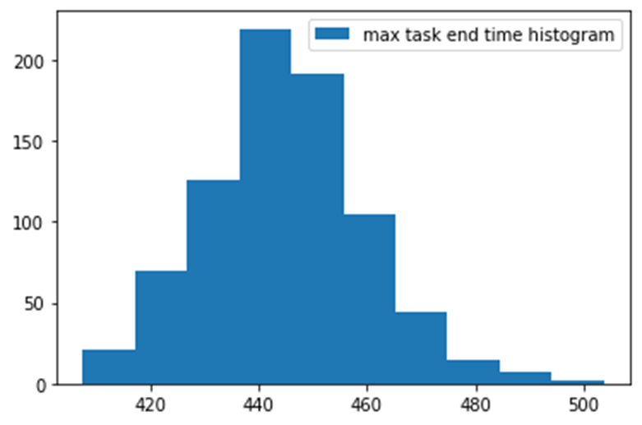
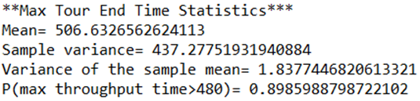
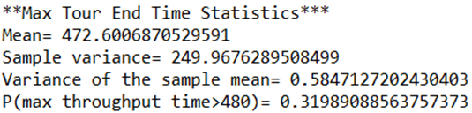
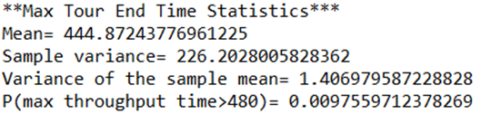
New Charging Policy, Varying Battery Sizes, 4 vans
battery_size = [20,20,20,20]
Charging Policy= New Charging Policy
battery_size = [25,25,25,25]
Charging Policy= New Charging Policy
battery_size = [30,30,30,30]
Charging Policy= New Charging Policy
With the probability of 0.8985, 4 vans cannot satisfy 8 hours constraint. Since, the company set the threshold for probability of maximum tour end time exceeding 8 hours as 0.05:
0.8985>0.05
So, 4 vans are NOT enough with this battery size and charging policy
With the probability of 0.3198, 4 vans cannot satisfy 8 hours constraint. Since, the company set the threshold for probability of maximum tour end time exceeding 8 hours as 0.05:
0.3198>0.05
So, 4 vans are NOT enough with this battery size and charging policy
With the probability of 0.0097, 4 vans cannot satisfy 8 hours constraint. Since, the company set the threshold for probability of maximum tour end time exceeding 8 hours as 0.05:
0.0097<0.05
So, 4 vans are enough with this battery size and charging policy
14
14

Slide 15
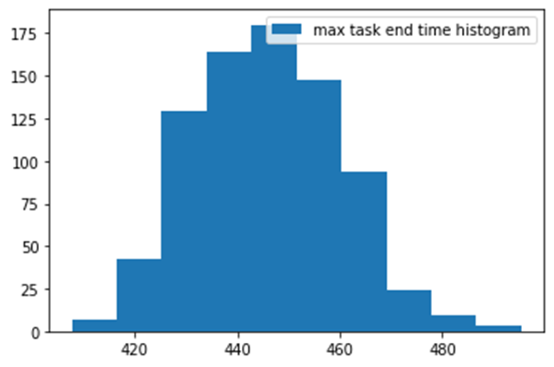
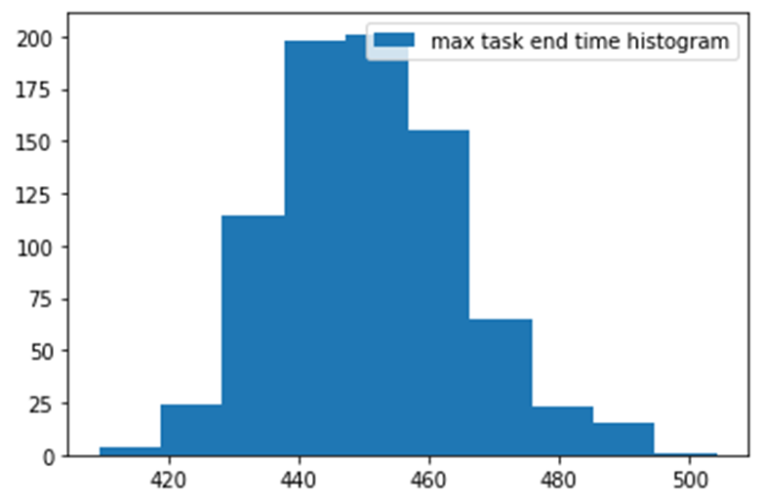
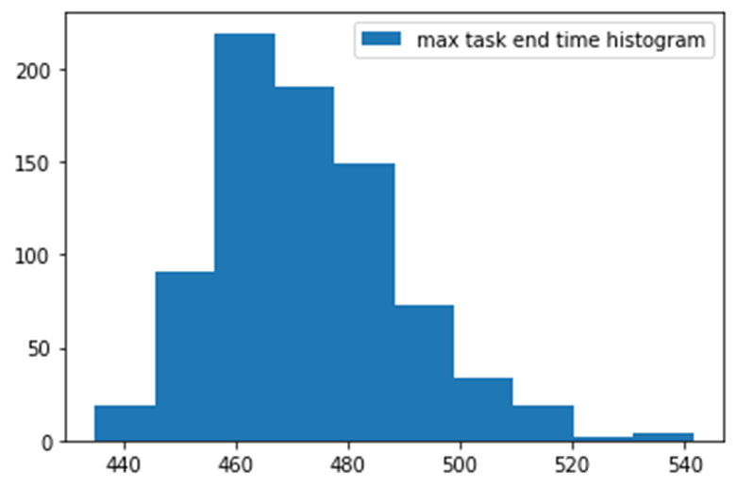
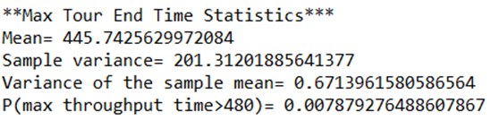
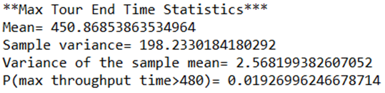
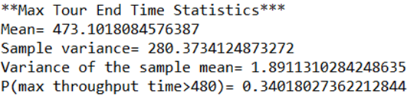
New Charging Policy, Varying Battery Sizes, 4 vans
battery_size = [35,35,35,35]
Charging Policy= New Charging Policy
battery_size = [30,30,20,20]
Charging Policy= New Charging Policy
battery_size = [25,25,20,20]
Charging Policy= New Charging Policy
With the probability of 0.0078, 4 vans cannot satisfy 8 hours constraint. Since, the company set the threshold for probability of maximum tour end time exceeding 8 hours as 0.05:
0.0078<0.05
So, 4 vans are enough with this battery size and charging policy
With the probability of 0.019, 4 vans cannot satisfy 8 hours constraint. Since, the company set the threshold for probability of maximum tour end time exceeding 8 hours as 0.05:
0.019<0.05
So, 4 vans are enough with this battery size and charging policy
With the probability of 0.34, 4 vans cannot satisfy 8 hours constraint. Since, the company set the threshold for probability of maximum tour end time exceeding 8 hours as 0.05:
0.34>0.05
So, 4 vans are NOT enough with this battery size and charging policy
15
15

Slide 16
DECISION MAKING USING SIMULATION OUTPUT ANALYSIS: Solving the Business Case
Having analyzed 12 possible scenarios with changing battery sizes and charging policies, the summary table is constructed, which can be seen on the right.
It can be summarized that:
New charging policy leads to significant improvements in the last mile delivery performance. In fact, if you compare the scenario 5 and scenario 11, the battery size of [30,30,20,20] can satisfy the 8 hours tour end time constraint for all 4 vans only when the new charging policy is used ,with the confidence of 98% (1-0.0193). Moreover, the New Charging Policy also dominates the Base Case Charging Policy in terms of the mean of the maximum tour end times of 4 vans, and also the probability of exceeding 8 hours tour end time.
Due to the success of the new charging policy, vans with smaller batteries can be used, which will lead to significant cost savings for the company.
Scenarios​ | Battery Size​ | Charging Policy​ | Mean of Max Tour End Times (Minutes) | P(Max Tour End Time >480) | 4 Vans are enough? | Daily Cost of 4 Vans
1​ | [20,20,20,20] ​ | Base Case Policy | 594.8 | 0.9966 | No | 420 €
2​ | [25,25,25,25]​ | Base Case Policy | 505.7 | 0.8109 | No | 480 €
3​ | [30,30,30,30]​ | Base Case Policy | 446 | 0.007 | Yes | 540 €
4​ | [35,35,35,35]​ | Base Case Policy | 444.8 | 0.0058 | Yes | 600 €
5​ | [30,30,20,20]​ | Base Case Policy | 476.3 | 0.4515 | No | 480 €
6​ | [25,25,20,20]​ | Base Case Policy | 511.3 | 0.8559 | No | 450 €
7​ | [20,20,20,20] ​ | New Policy | 506.6 | 0.8986 | No | 420 €
8​ | [25,25,25,25]​ | New Policy | 472.6 | 0.3199 | No | 480 €
9​ | [30,30,30,30]​ | New Policy | 444.9 | 0.0098 | Yes | 540 €
10​ | [35,35,35,35]​ | New Policy | 445.7 | 0.0079 | Yes | 600 €
11​* | [30, 30,20,20]​* | New Policy* | 450.9 | 0.0193 | Yes* | 480* €
12​ | [25,25,20,20]​ | New Policy | 473.1 | 0.34 | No | 450 €
Cost Savings
Battery Size= [35,35,35,35] (Previous Setting)
Charging Policy= Base Case Charging Policy
Daily Cost of 4 vans = 4 vans * 150€/(van*day)=600€/day
Battery Size= [30,30,20,20] (New Setting)
Charging Policy= New Charging Policy
Daily Cost of 4 vans = 2 vans * 135€/(van*day) + 2 vans * 105€/(van*day) = 480€/day
Saving= 600€/day – 480€/day = 120€/day
Saving Ratio= 120/600= 20%
Conclusion to the Case Study
Considering the simulation outputs and the preferences of the company:
The charging policy will be changed to the New Charging Policy
Battery sizes of the vans will be set to [30,30,20,20], meaning that Van_0 and Van_1 will have 30 kwh batteries, Van_2 and Van_3 will have 20 kwh batteries.
In this setting, the company will have 120 €/day saving, which is a 20% saving compared to the inital system configuration
Further Considerations
We can see that, in the scenario 12, 4 vans can complete the tour in 8 hours with 66% confidence. The decision maker may consider the tradeoff between paying overtime to delayed vans and saving 30€/day. If overtime is an option for the company, this aspect is also worth considering.
16

Slide 17
CONCLUSION
In the second assignment, we determined the most important system performance to measure which is the minimum number of vans to serve all customers under 8 hours. As the proxy of the minimum number of vans necessary, we chose the maximum of tour end times, which is used to identify if the given number of vans are enough to satisfy 8 hours maximum tour end time constraint with a confidence level. Depending on the preference of the decision maker on the probability of going overtime, the number of vans can vary (e.g. In the business case we introduced it was 95%).
We determined the two most important factors which are charging policy and battery sizes of vans that have significant effects on the chosen system performance measure. For 12 different configurations of the system considering the two factors, we determined the number of runs required to have a more reliable result and we selected the highest number of runs (800 runs) needed among these 12 different configurations. We conducted single factor experiments to prove the impacts of the chosen factors on the system performance measure are significant. We fixed one of the chosen factors while changing the level of the other factor. For each experiment, we conducted one-way ANOVA test and proved that the change in charging policy and battery size significantly affect maximum tour end time.
Finally, we formulated a hypothetical business case in which the decision-maker is trying to find the optimal number of vans to use depending on different system configurations considering charging policy and battery size. In the business case, the decisionmaker can observe the benefit of using the new charging policy over the base case policy. Considering tradeoff between vans with smaller battery sizes which are cheaper and having smaller max tour end times by using the vans with bigger battery sizes. The decisionmaker can save costs by choosing the right combination of battery sizes and charging policies while the van fleet still can serve all the customers in 8 hours with a little risk of overtime (under 5%).
17
17

